Slide 1
Introduction and Asymptotic Notations
CS/IT, UCER Prayagraj

Slide 2
Design and Analysis of Algorithm(KCS503)
Books
Thomas H Coremen
E Horowitz and S. Sahani

Slide 3
What is an algorithm?
Algorithm is a set of steps to complete a task.
An algorithm is any well-defined computational procedure that takes some value, or set of values, as input and produces some value, or set of values, as output.
An algorithm is thus a sequence of computational steps that transform the input into the output.
2

Slide 4
Characteristics of an algorithm
Must take an input.
Must give some output(yes/no , value etc.)
Definiteness –each instruction is clear and unambiguous.
Finiteness –algorithm terminates after a finite number of steps.
Effectiveness –every instruction must be basic i.e. simple instruction
2

Slide 5
Design Strategy
Divide and Conquer
Dynamic Programming
Branch and Bound
Greedy Approach
Backtracking
Randomized algorithm
2

Slide 6
ANALYSIS OF ALGORITHMS
Analyzing an algorithm has come to mean predicting the resources that the algorithm requires. Occasionally, resources such as memory, communication bandwidth, or computer.
Running Time of an algorithm is the time taken by the algorithm to execute the successfully. The running time of an algorithm on a particular input is the number of primitive operations or "steps" executed. It is convenient to define the notion of step so that it is as machine independent as possible.

Slide 7
Pseudo Code
High-level description of an algorithm
More structured than English prose
Less detailed than a program
Preferred notation for describing algorithms
Hides program design issues

Slide 8
Example: find max element of an array
Algorithm arrayMax(A, n)
Input array A of n integers
Output maximum element of A
currentMax ← A[0]
for i ← 1 to n − 1 do
do if A[i] > currentMax
then currentMax ← A[i]
return currentMax
And or
A[1..10]

Slide 9
How to analyse time complexity
Algorithm arrayMax(A, n)
# operations
currentMax ← A[0] 1
for i ← 1 to n − 1 n
do
if A[i] > currentMax (n − 1)
then currentMax ← A[i] (n − 1)
return currentMax 1
Total 3n
T(n)= O(n)
100 n + 500

Slide 10
How to analyse time complexity
Sum_of_list(A[],n)
{ int total=0;
for i=0 to n-1
do total = total + A[i]
return total
}

Slide 11
How to analyse time complexity
Sum_of_list(A[],n) cost time
{ int total=0; c1 1
for i=0 to n-1 c2 n+1
do total = total + A[i] c3 n
return total c4 1
}
T(n)= 2n + 3
=O(n)

Slide 12
for (int i = 1; i <=m; i += c)
{ // some O(1) expressions }
for (int i = 1; i <=n; i += c)
{ // some O(1) expressions }
Time complexity of above code is O(m) + O(n) which is O(m+n)
If m == n, the time complexity becomes O(2n) which is O(n).

Slide 13
for(int i = 0; i < N; i++) c1 n +1 for (int j = i; j < N; j++) c2 n * (n+1) {
printf(“%d” ,i); c3 n* n *1 }
T (n) = n+1 + n * (n+1)+ n* n *1= O(n^2) =

Slide 14
ASYMPTOTIC NOTATION
Give a simple characterization of an algorithm’s efficiency.
Allow comparison of performances of various algorithms.
Asymptotic Notations are the expressions that are used to represent the complexity of an algorithm.
2

Slide 15
The notation we use to define the running time of an algorithm , are defined in terms of functions whose domains are natural number.

Slide 16
ASYMPTOTIC NOTATION (Contd)
Best Case: In which we analyze the performance of an algorithm for the input, for which the algorithm takes less time or space.
Worst Case: In which we analyze the performance of an algorithm for the input, for which the algorithm takes long time or space.
Average Case: In which we analyze the performance of an algorithm for the input, for which the algorithm takes time or space that lies between best and worst case.
2

Slide 17
ASYMPTOTIC ASYMPTOTIC NOTATION (Contd)
Big-oh Notation (O)
Big-Omega Notation ()
Theta Notation ( )
3

Slide 18
Ο(g(n)), Big-Oh of g of n, the Asymptotic Upper Bound.
Ω(g(n)), Big-Omega of g of n, the Asymptotic Lower Bound.
Θ(g(n)), Big-Theta of g of n, the Asymptotic Tight Bound.

Slide 19
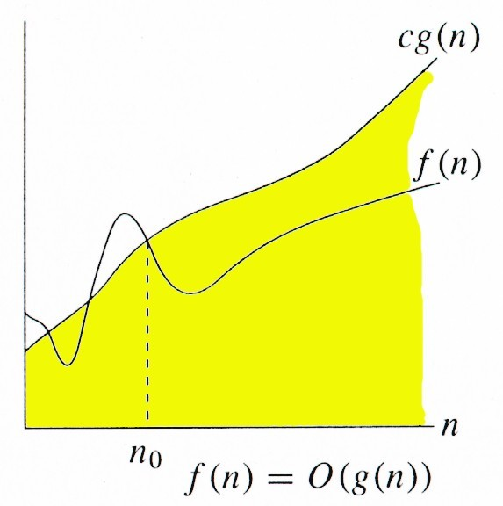
BIG-OH NOTATION (O)
Gives the upper bound of algorithm’s running time.
Let g(n) be a function.
O(g(n)) = { f(n) | there exists a constant c and a natural number n₀ such that
that 0 ≤ f(n) ≤ c g(n) for all n>= n₀ }
4

Slide 20
Big-Oh Example
Example: the function n² is not O(n)
n² ≤ cn
n ≤ c
The above inequality cannot be satisfied since c must be a constant

Slide 21
Examples Show that 3n³=O(n⁴) for appropriate c and n₀.
Solution : According to big oh definition
there exists a constant c and a natural number n₀ such that 0 ≤ f(n) ≤ c g(n) for all n>= n₀
Ac 3n³ ≤ c n⁴ for all n>= n₀
Divided by n⁴ we get
3/ n ≤ c for all n>= n_{0…………………..(1)}
Putting n=1,2,3,4…. we get 3, 1.5, 1,.75, .6………….
_{we take} c=3 and n₀ = 1 hold the condition 1
Hence 3n³=O(n⁴) proved.

Slide 22
Example : Show that 7n-2 is O(n) for appropriate c and n₀.
Solution : According to big oh definition
there exists a constant c and a natural number n₀ such that 0 ≤ f(n) ≤ c g(n) for all n>= n₀
7 n - 2 ≤ c n for all n>= n₀
Divided by n we get
7 – 2/n ≤ c for all n>= n_{0…………………..(1)}
Putting n=1,2,3,4…. we get 5 , 6 , 6.33, 6.5 , 6.6, 6.66 ,……
c= 7 and n0 = 1 hold the condition 1
Hence 7 n – 2 = O ( n ) proved.

Slide 23
Example Show that 3 log n + 5 is O(log n) for appropriate c and n₀.
Solution According to big oh definition
there exists a constant c and a natural number n₀ such that 0 ≤ f(n) ≤ c g(n) for all n>= n₀
3 log n + 5 ≤ c log n for all n>= n₀
Divided by log n we get
3 +5/log n ≤ c for all n>= n_{0…………………..(1)}
Putting n=1,2,3,4…. we get 0, 8, , 5.5 ….
Take c= 8 and n₀ = 1 hold the condition 1
Hence 3 log n + 5 = O(log n) proved.

Slide 24
Examples
Show that 3n³ + 20n² + 5 is O(n³)for appropriate c and n₀.
Show that n ² + n = O (n ³)
Show that 5 n ³ – 6 n + 100 = O (n ³)

Slide 25
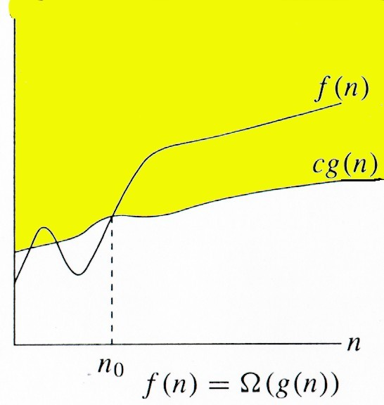
BIG-OMEGA NOTATION (Ω)
Gives the lower bound of
algorithm’s running time.
For a given function g(n), we denote by Ω(g(n))
Ω(g(n)) = {f(n): there exist positive constants c and n0 such that 0 ≤ cg(n) ≤ f(n) for all n ≥
n0}.
5

Slide 26
Example : Show that 5n² is Ω(n)
Solution :
f(n) is Ω(g(n)) if there is a constant c > 0 and an integer constant n₀ ≥ 1 such that 0 ≤ cg(n) ≤ f(n) for n ≥ n₀
c n <= 5n² for n ≥ n₀
c <= 5 n for n ≥ n_{0 ………………….(1)}
Putting = 1,2 ,3 4……. We get 5, 10 ,15…………..
let c = 1 and n₀ = 1 hold equation (1)
\

Slide 27
THETA NOTATION (Θ )
This notation describes both upper bound and lower bound of an algorithm so we can say that it defines tight bound .For a given function g(n), we denote by Θ(g(n)) the set of functions and read as Θ of g(n).
It is defined as
Θ(g(n)) = {f(n) : there exist positive constants c1, c2, and n0 such that 0 ≤ c1g(n) ≤ f(n) ≤ c2g(n) for all n ≥ n0}.
6

Slide 28
Question : Consider the function f(n)= n² /2 – 3 n . Show that f(n) = Θ (n²).
Solution:
According to the definition
Θ(g(n)) = {f(n) : there exist positive constants c1, c2, and n0 such that 0 ≤ c1g(n) ≤ f(n) ≤ c2g(n) for all n ≥ n0}.
so, we must determine positive constants c1, c2, and n0 such that
c1 n² ≤ n² / 2 - 3n ≤ c2 n² for all n ≥ n0.
Dividing by n² yields
c1 ≤ 1/2 - 3/n ≤ c2. for all n ≥ n0.

Slide 29
c1 ≤ 1/2 - 3/n ≤ c2. for all n ≥ n0. ……………(1)
Putting n=1,2,3,4…..
We get - 5/2 ,-1, -1/2 , -1/4, -1/10, 0, 1/14, 1/8 ,1/6,1/5………………..
1/2 - 3/n ≤ c2 The right-hand inequality can be made to hold for any value of n ≥ 1 by choosing c2 ≥ 1/2.
Likewise, c1 ≤ 1/2 - 3/n the left-hand inequality can be made to hold for any value of n ≥ 7 by choosing c1 ≤1/14.
Thus, by choosing c1 = 1/14, c2 = 1/2, and n0 = 7, we can verify that n² /2 - 3n = Θ(n²).

Slide 30
Question : Show that 3n+2= θ (n).
Solution: According to the definition
Θ(g(n)) = {f(n) : there exist positive constants c1, c2, and n0 such that 0 ≤ c1g(n) ≤ f(n) ≤ c2g(n) for all n ≥ n0}.
c1n ≤ 3 n + 2 ≤ c2 n for all n ≥ n0
Divided by n we get
c1 ≤ 3 + 2 / n ≤ c2 for all n ≥ n0…………..(1)
Consider left part
c1 ≤ 3 + 2 / n by putting n= 1,2,3…..
We get 5, 4, 3.66,3.5,…..we take c1=3 and n0 =1
Consider right part
3 + 2 / n ≤ c2 we take c2= 5 and n0 =1 hold equation (1)
Hence c1=3 , c2= 5 and n0= 1 this condition satisfied.

Slide 31
Example Is 2 ^{n +1} = O ( 2 ^{n} ) ?
Solution : According to big oh definition
there exists a constant c and a natural number n₀ such that 0 ≤ f(n) ≤ c g(n) for all n>= n₀
2 ^{n +1} ≤ c 2 ^{n} for all n>= n₀
Divided by 2 ^{n} we get
2<= c for all n>= n₀
Hence for c>= 2 and n0 can have any values.it holds always

Slide 32
Question :Is 2 ^{2n} = O ( 2 ^{n} ) ?
Solution : According to big oh definition
there exists a constant c and a natural number n₀ such that 0 ≤ f(n) ≤ c g(n) for all n>= n₀
2 ^{2n} ≤ c 2 ^{n} for all n>= n₀
Divided by 2 ^{n} we get
2 ^{n} <= c for all n>= n₀
Putting n= 1,2,3,4,5, we get 2,4,8,16,32………….
This gives series is exponentially grow thus no value of c can be found and hence this is false .

Slide 33
Example :Show that 3n³ + 20n² + 5 is O(n³)for appropriate c and n₀.
Solution : According to big oh definition
there exists a constant c and a natural number n₀ such that 0 ≤ f(n) ≤ c g(n) for all n>= n₀
3n³ + 20n² + 5 ≤ c n ³ for all n>= n₀
Divided by n ³ we get
3+ 20/n+5/ n ³ ≤ c for all n>= n_{0…………………..(1)}
Putting n=1,2,3,4………..
We get 28, 13.625,9.845,…, 7.004……..5.005,4.816,……..3.200005
we take c= 28 and n0=1 hold equation (1).
Hence Proved .

Slide 34
Question : Show that 6 n ² + 100 n +3006 = θ (n ²).
Solution :
According to the definition
there exist positive constants c1, c2, and n0 such that 0 ≤ c1g(n) ≤ f(n) ≤ c2g(n) for all n ≥ n0
c1 n ² ≤ 6 n ² + 100 n +3006 ≤ c2 n ² for all n ≥ n0
Divided by n ²
c1 ≤ 6 + 100 /n +3006 / n ² ≤ c2 for all n ≥ n0…….(1)
Putting n=1,2,3,4…………we get 3112 , 807.5 , 373.3……….,46.06, …….. 7.3006,………….6.103006
We take c1 <= 6 and c2 =8 and n0=100 holds equation (1)

Slide 35
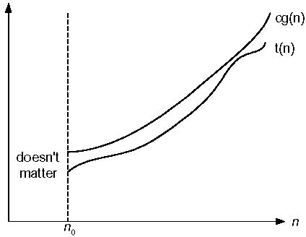
LITTLE OH NOTATION (o)
little-Oh Defn:
f(n) = o(g(n))
○ If for all positive constants c there exists an n₀ such that f(n) < c· g(n) for all n >= n₀.
8

Slide 36
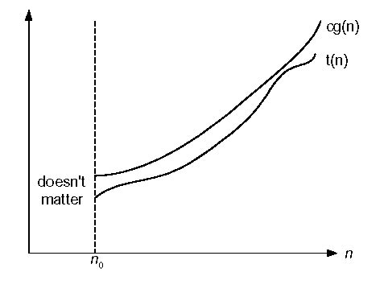
LITTLE OMEGA NOTATION (ω)
little-Omega Defn:
f(n) = w(g(n))
○ If for all positive constants c there exists an n₀ such that c· g(n) < f(n) for all n  n₀.
9

Slide 37
Mathematical LITTLE Oh NOTATION (ο)
In mathematical relation f(n) = o(g(n)) means lim f(n)/g(n) = 0 n→∞
f(n) has smaller order of growth than g(n).
2. In mathematical relation f(n) = w(g(n)) means lim f(n)/g(n) = infinite n→∞
f(n) has larger order of growth than g(n).
3. In mathematical relation f(n) = θ (g(n)) means lim f(n)/g(n) = constant c n→∞
9

Slide 38

Mathematical Relation
For little o notation
Example If f(n) = n² and g(n) = n³ then check whether f(n) = o(g(n)) or not.
Solution :
Lim f(n)/g(n)= n^{2 /} n^{3 = 1/infinite} =0
n→∞
The result is 0, and it satisfies the equation mentioned above. So we can say that f(n) = o(g(n)).

Slide 39
Examples: Is 7n + 8 ∈ o(n²)?
Solution :Mathematically we get
lim f(n)/g(n) = lim (7n + 8)/(n²) = lim 7/2n = 0 n→∞ n→∞ n→∞
hence 7n + 8 ∈ o(n² ) proved.

Slide 40
TIME COMPLEXITY
Dependency of
the time it takes to solve a problem
as a function of the problem dimension/size
Examples:
Sorting a list of length n
Searching a list of length n
Multiplying a n×n matrix by an n×1 vector
Time to solve problem might depend on data
Average-case time
Best-case time
○ data is well suited for algorithm (can’t be counted on)
Worst-case time
○ data is such that algorithm performs poorly (time-wise)
Worst-Case gives an upper bound as to how much time will be needed to solve any instance of the problem
10

Slide 41
Thank You
11

